Slide 1




Slide 2
We are…
Anish Virani (110420107016)
Mohit Gandhi (110420107026)
Jay Patel (110420107021)
Ujjaval Prajapati (110420107034)
Guide by : Prof. Vaikhari Deodhar

Slide 3
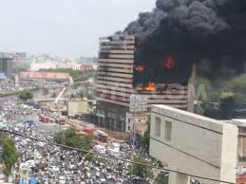
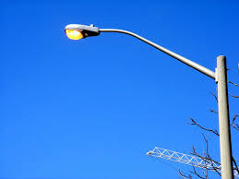
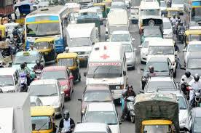
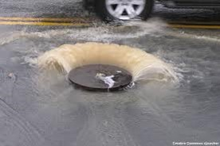
Problems currently faced in cities
Fire increased due to delay in getting information about it.
Street light ON at day time.
Ambulance stuck in traffic due to lack of information about traffic on different roads .
Drainage overflow in cities.

Slide 4
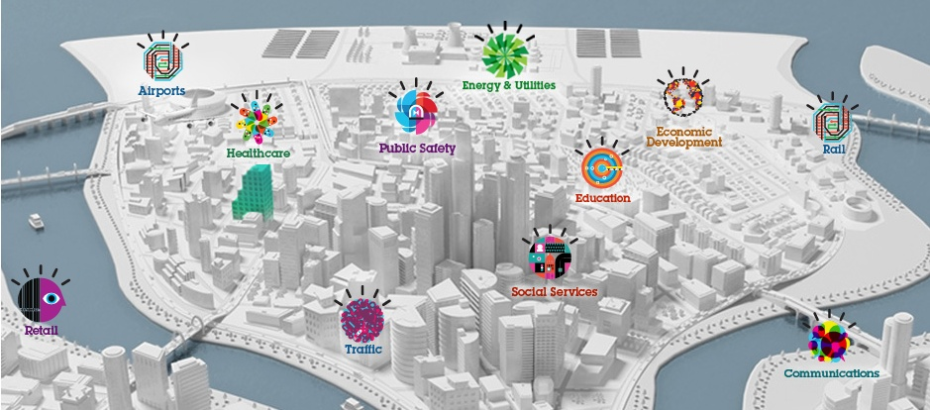
Smart City
Smart City refers to the city automated in various aspects. These aspects
could be traffic analysis, street light control, fire detection, drainage-overflow
detection, gas-leakage detection, temperature measurement etc.

Slide 5
IBM’s concept of SmartCity
Concepts | Description
Intelligent transportation | Citywide visibility across entire transportation network and city services to improve incident response
Traffic | Analyzing patterns of traffic conditions, traffic flow graphs and event reports.
Energy and Utilities | IBM is helping utilities add a layer of digital intelligence to their grids.
Public safety | Unified view across crime, emergency management, terrorism, etc. data sources to protect citizens, business and government.
Water solution | Visibility across the water network to improve operational planning and prioritization and to monitor water quality.
Education | Analytics, cloud computing and early warning prediction can make education system smarter

Slide 6
Goal
We will formulate model of a miniature of city.
The model will be incorporated with different types of sensors like light detectors, fire detectors, drainage-overflow detectors, gas-leakage detectors, temperature detectors, etc.
The software will encompass an API of map implemented and will demonstrate the visual representation of the data received on the equivalent map of the city.

Slide 7
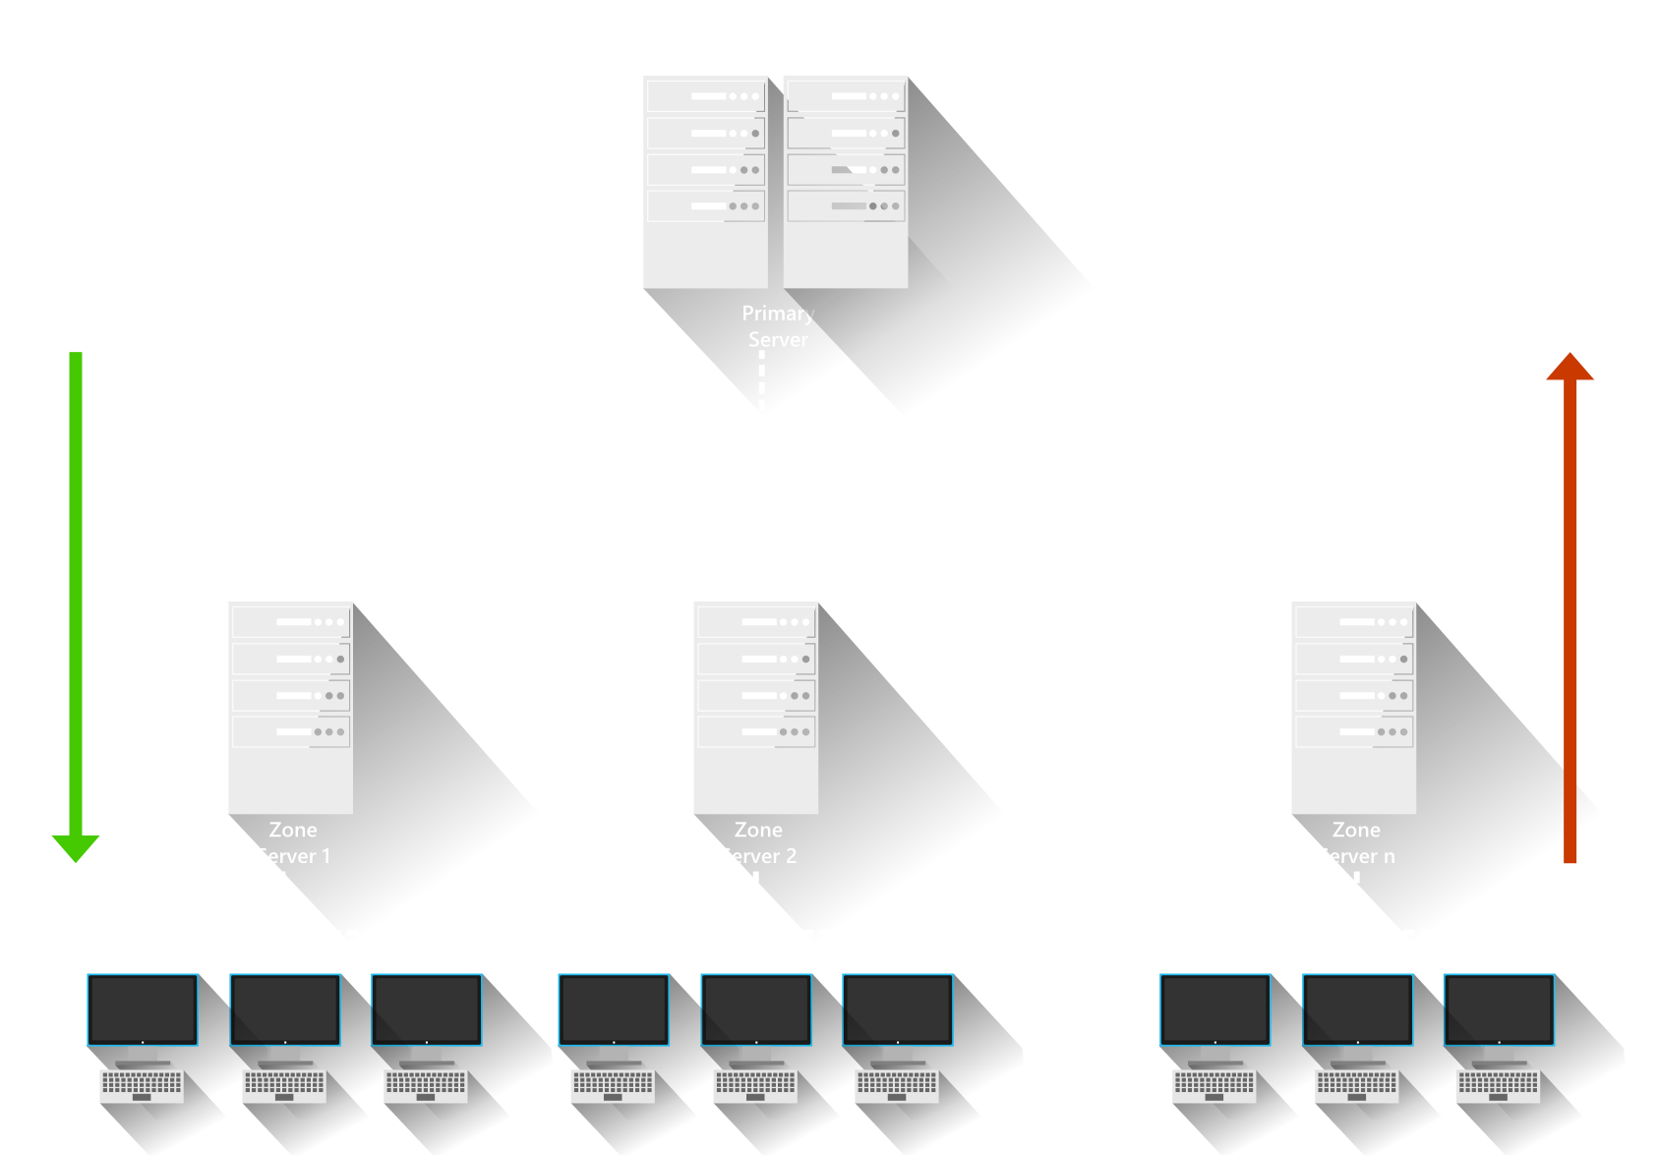
System Architecture

Slide 8

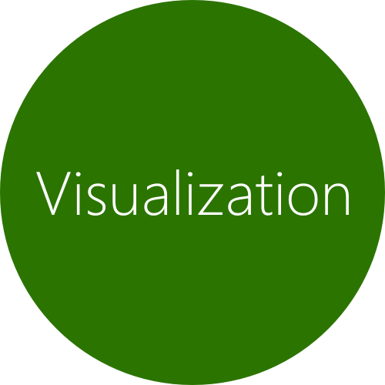
Functionality

Slide 9
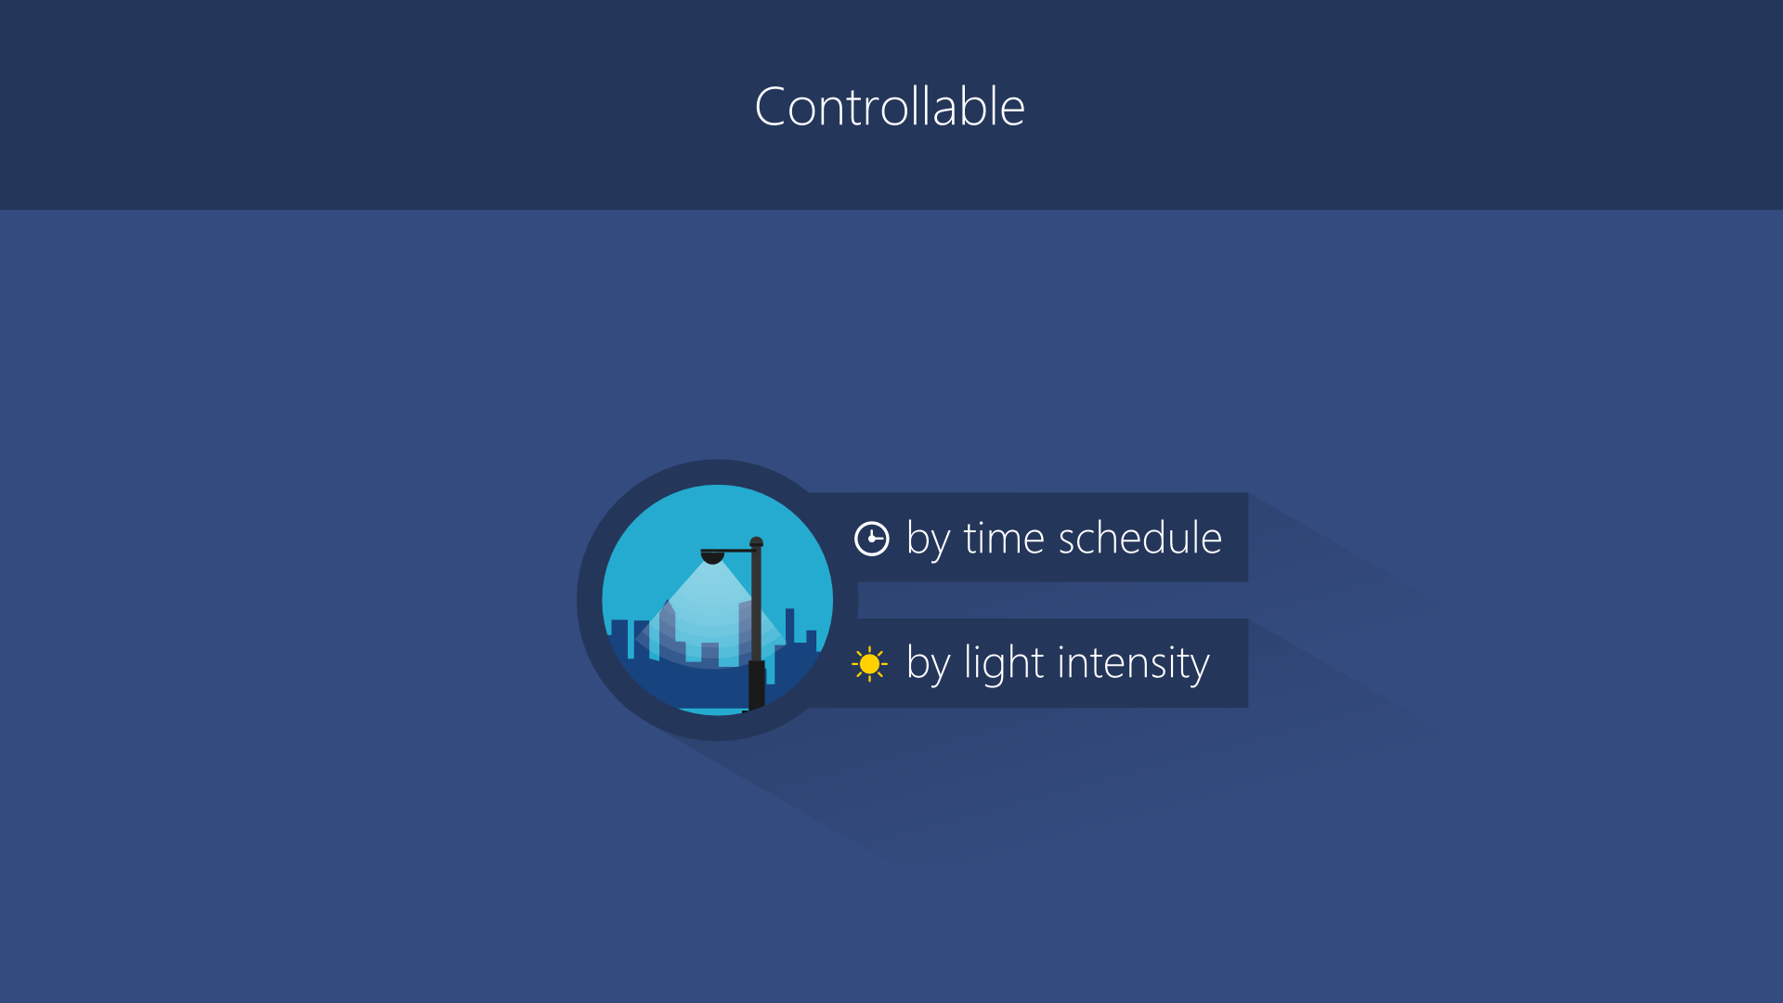

Slide 10
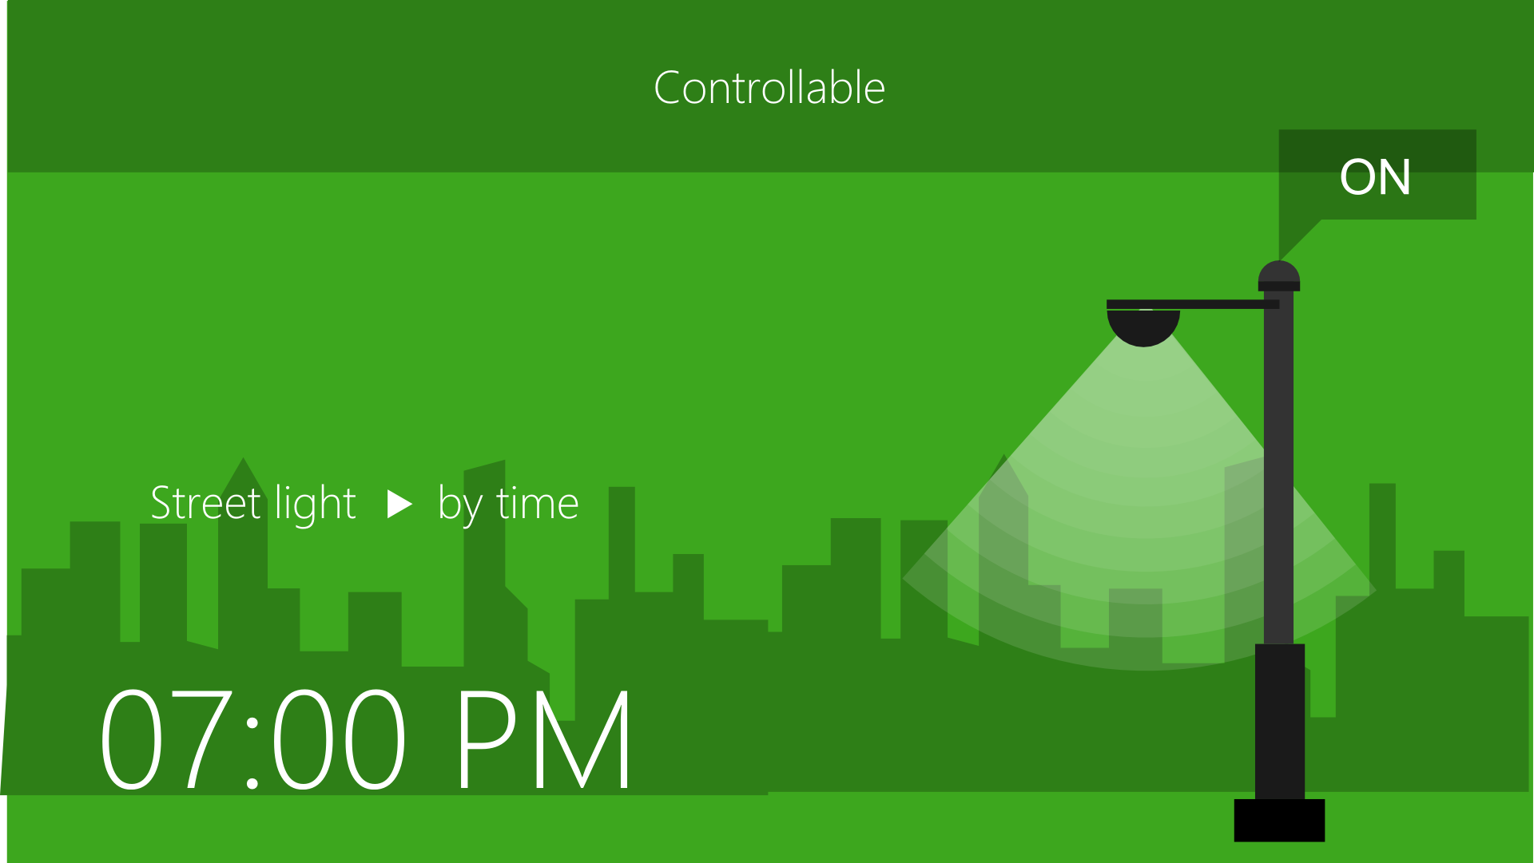
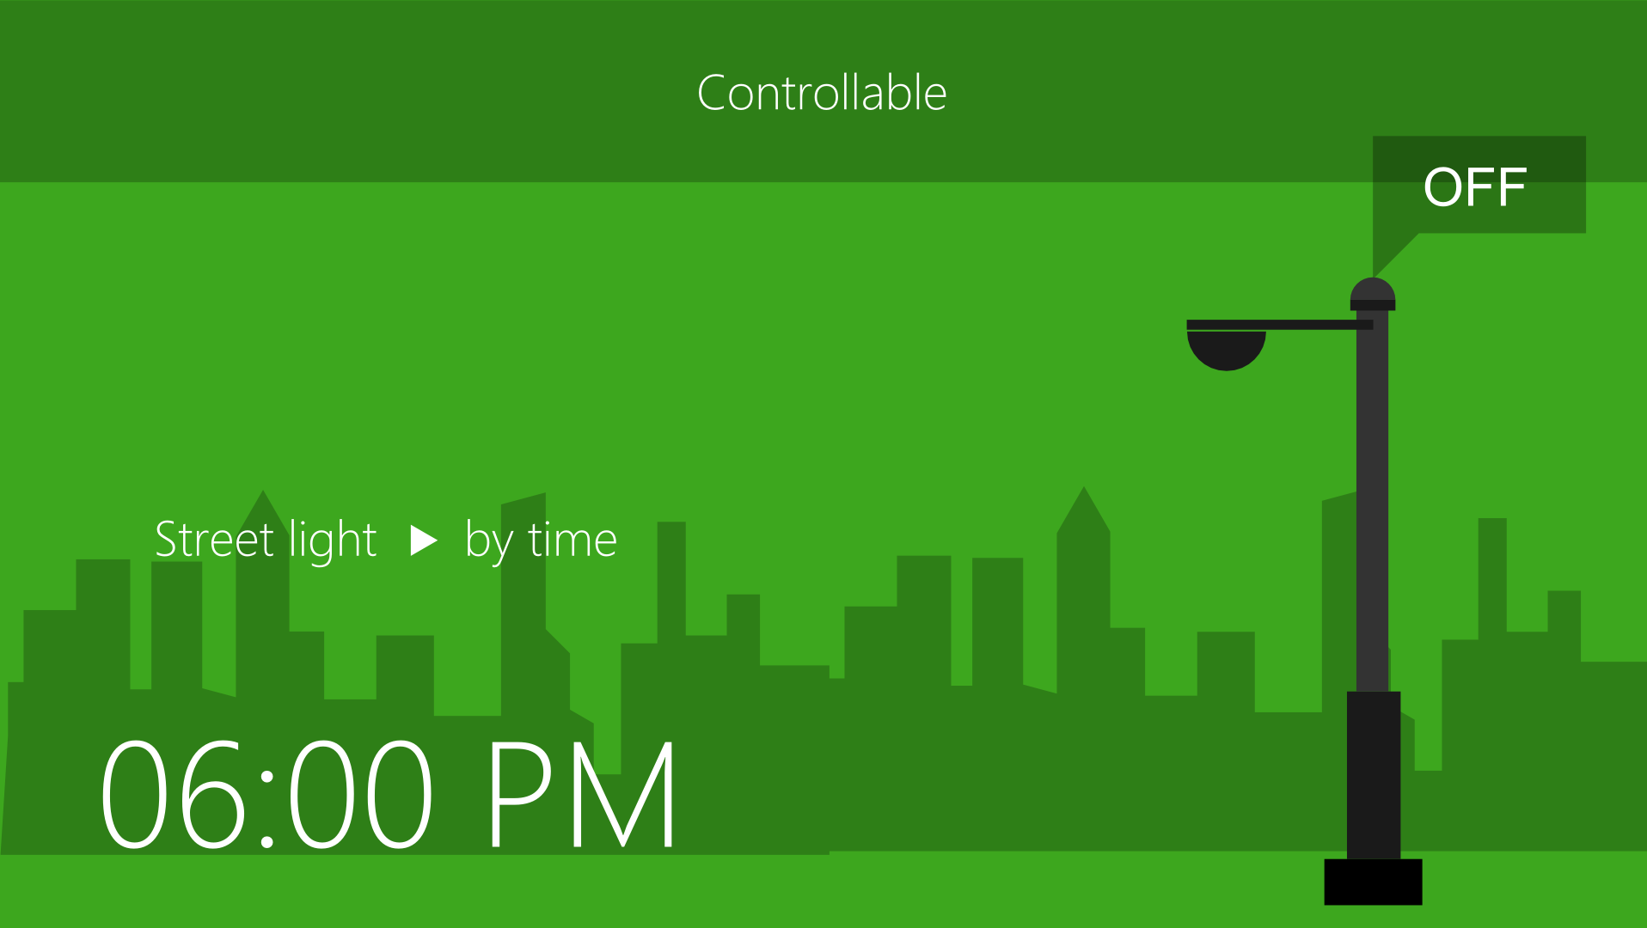

Slide 11
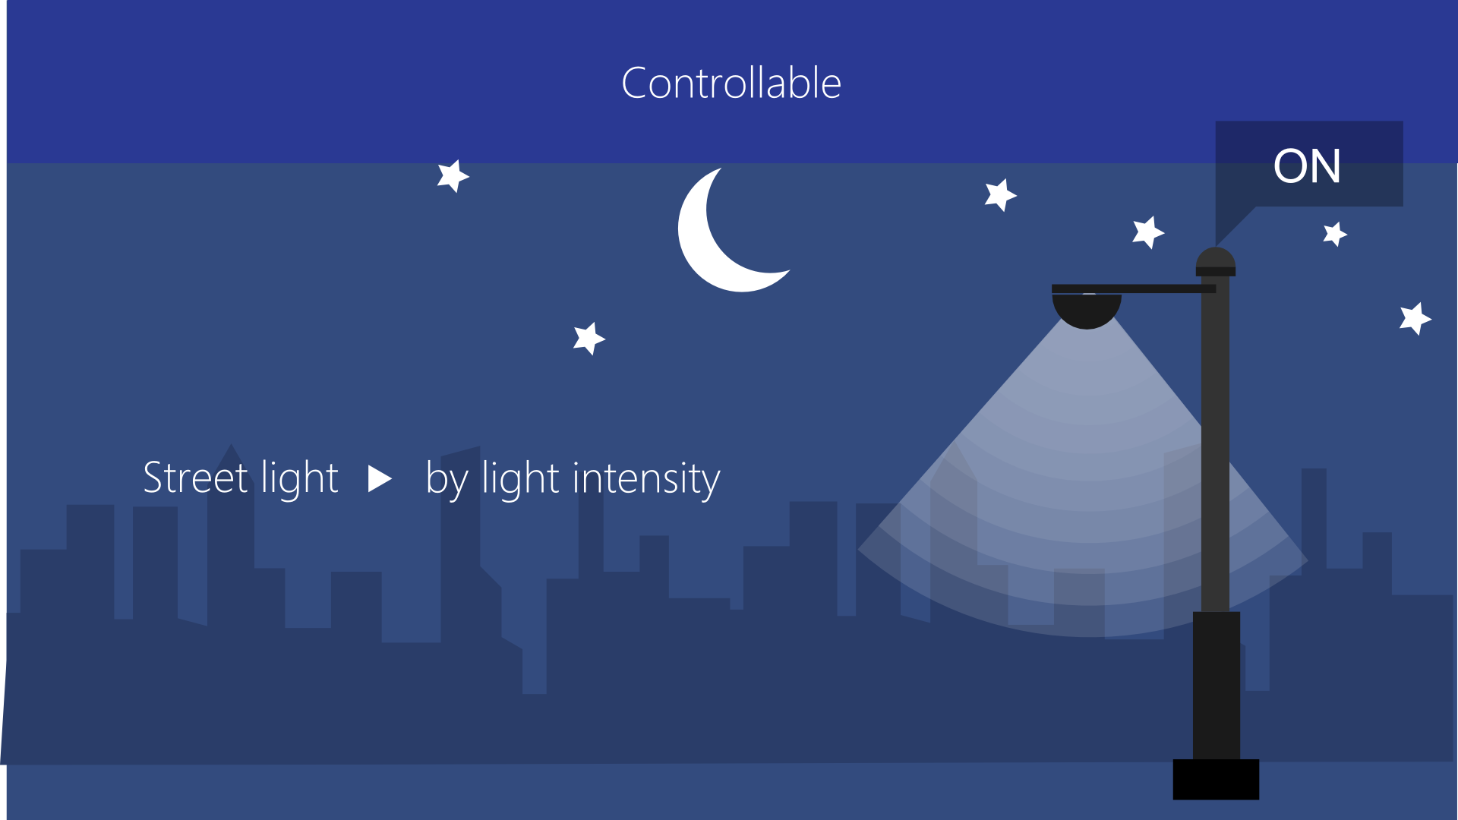
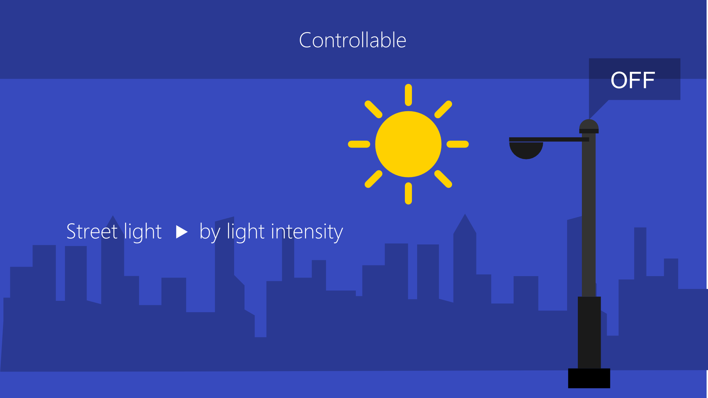

Slide 12

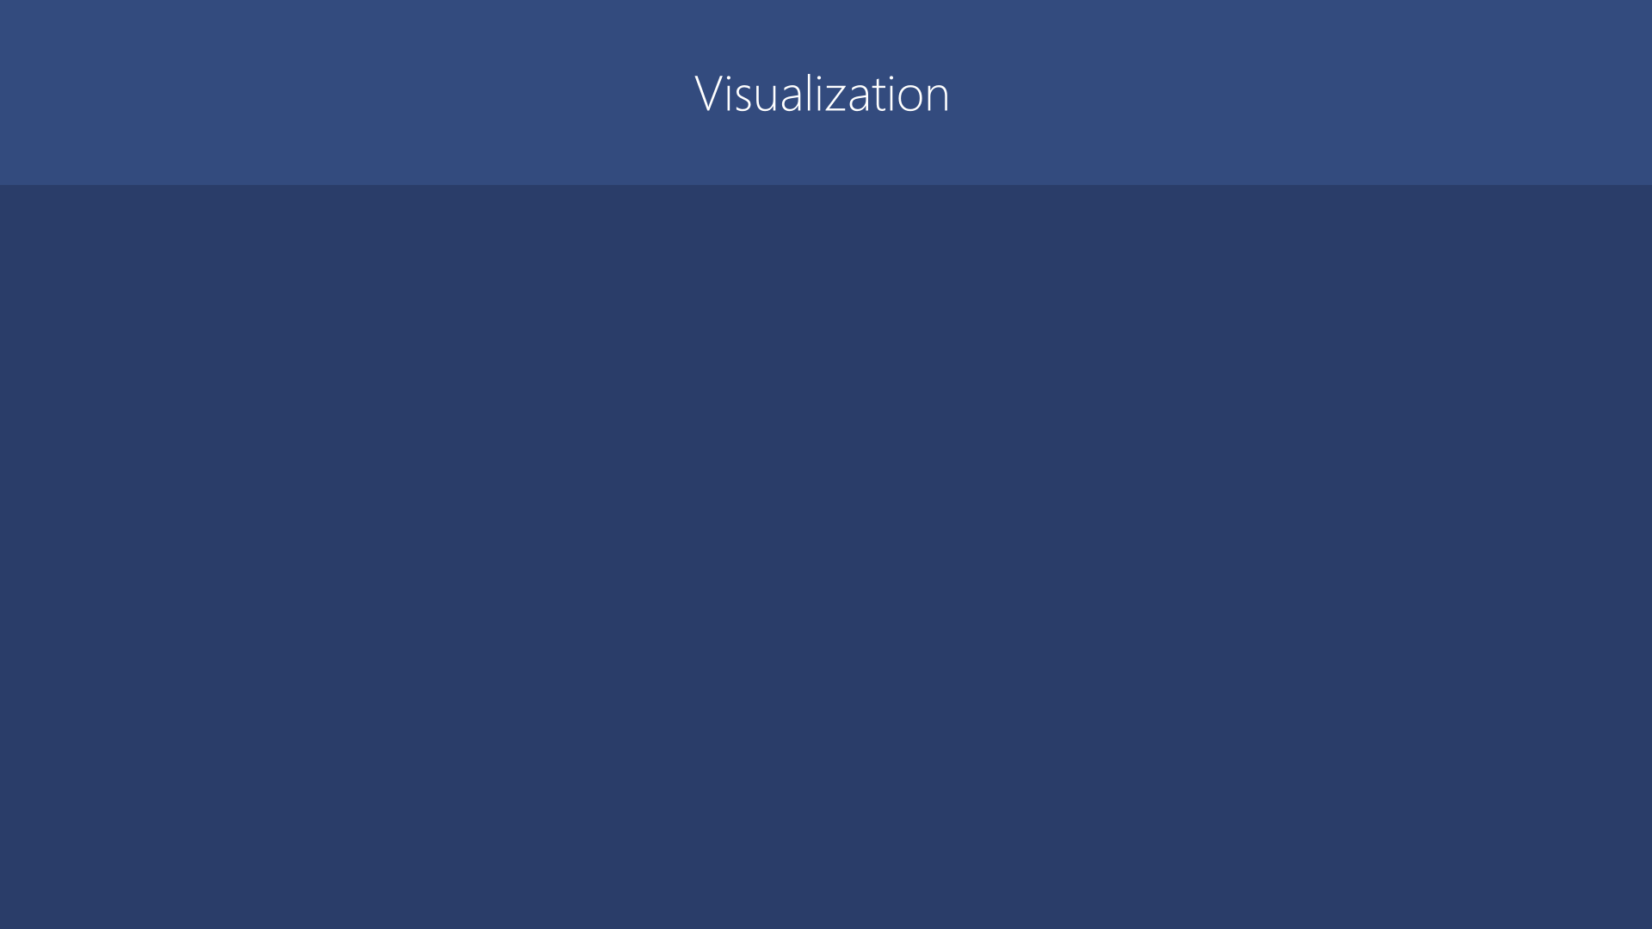
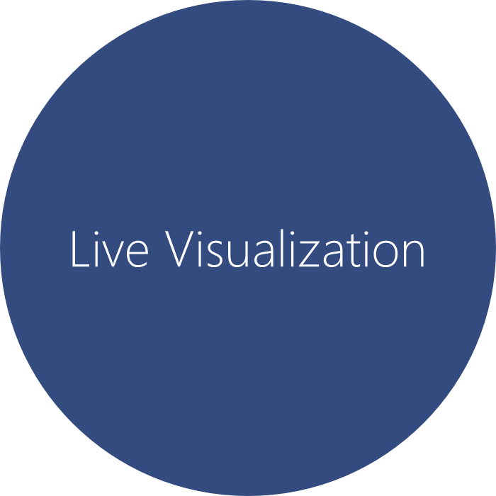
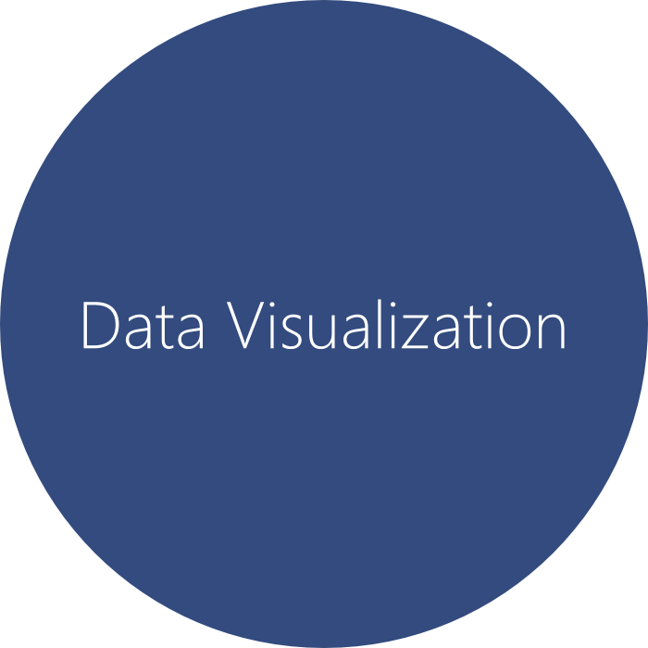

Slide 13
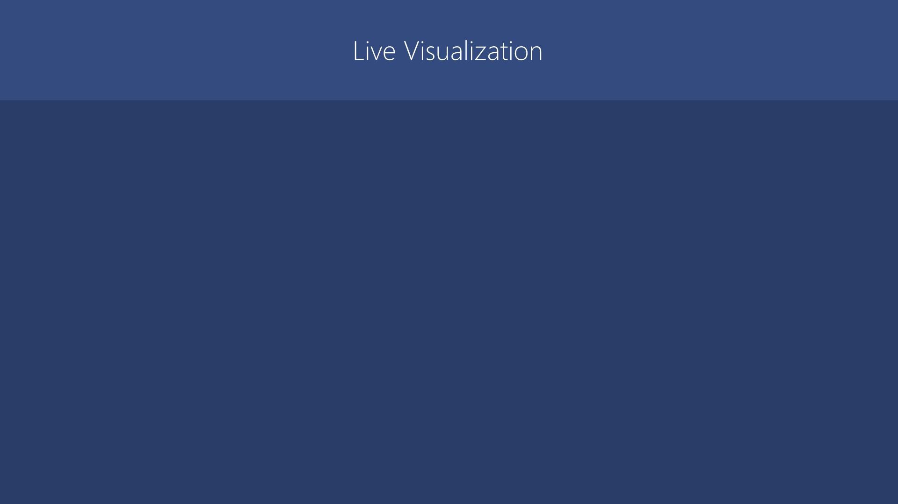

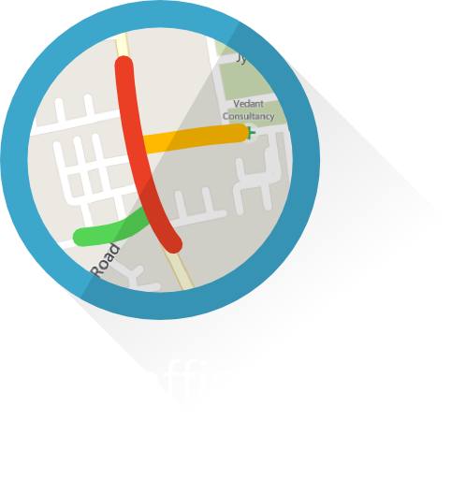

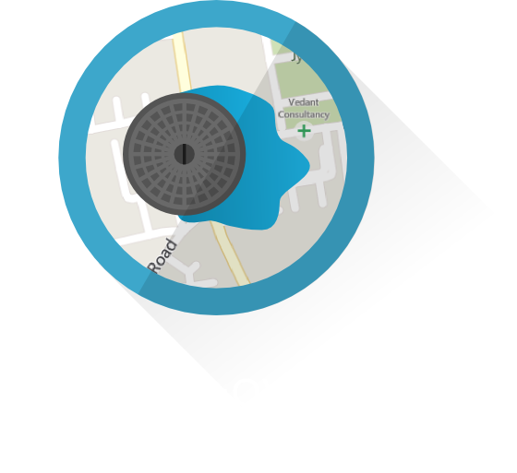
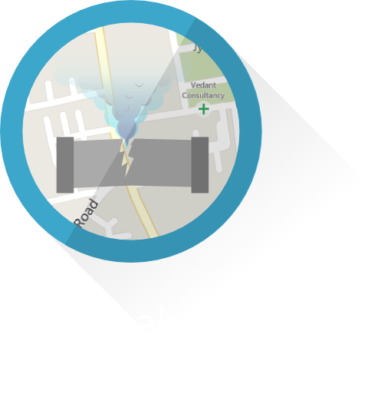
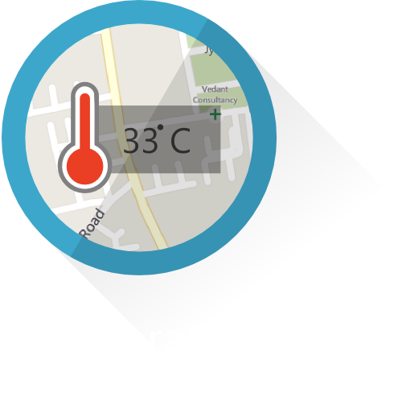

Slide 14

Traffic Analysis
Traffic will be analyzed by processing the captured video of the road and the visual representation of it will be shown on the map publicized in the software.
We will process the video by using OpenCV framework.

Slide 15
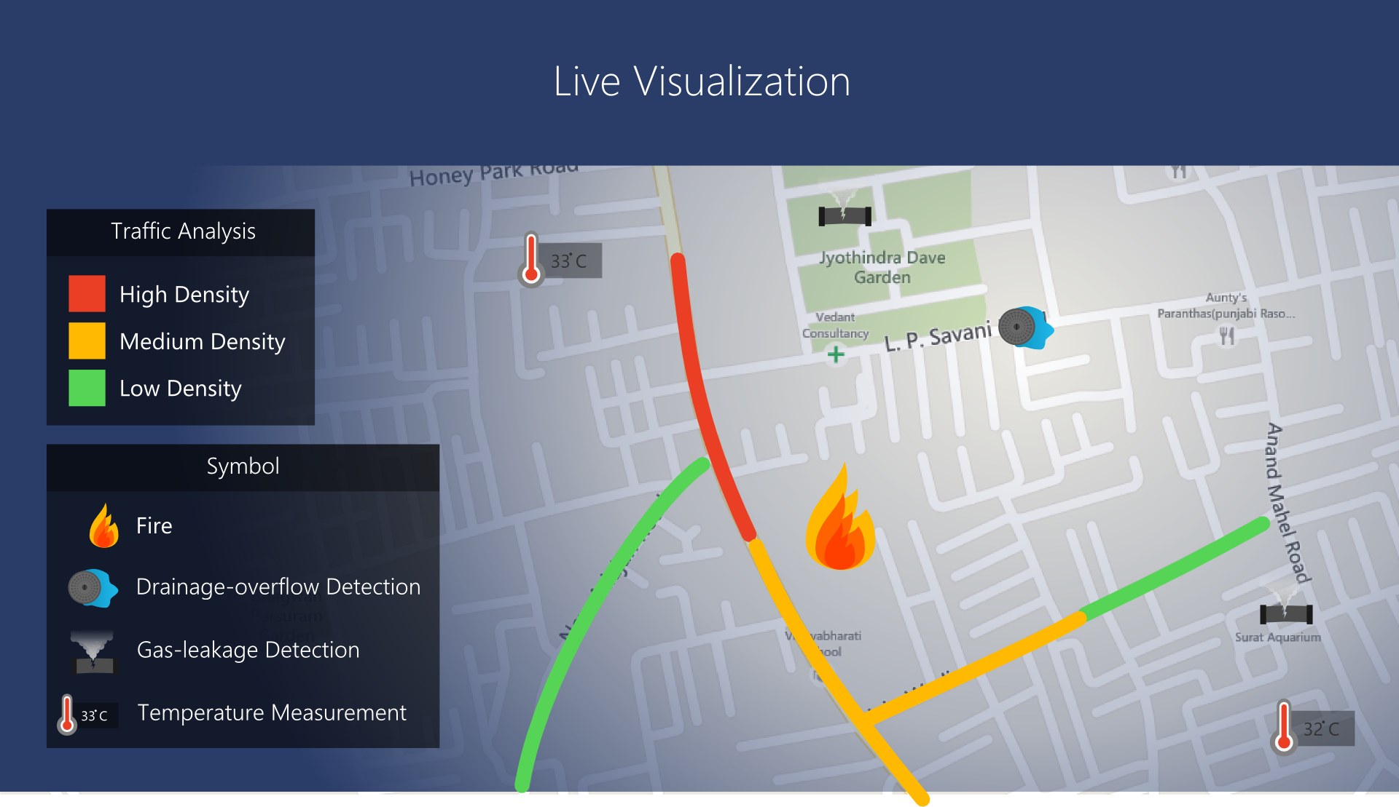

Slide 16
Data Visualization involves the creation and study of the visual representation of data. The main goal of data visualization is to communicate information clearly and effectively through graphical means.
We will show the visualization of previously recorded data for traffic analysis, gas leakage, fire, drainage.
Data Visualization

Slide 17
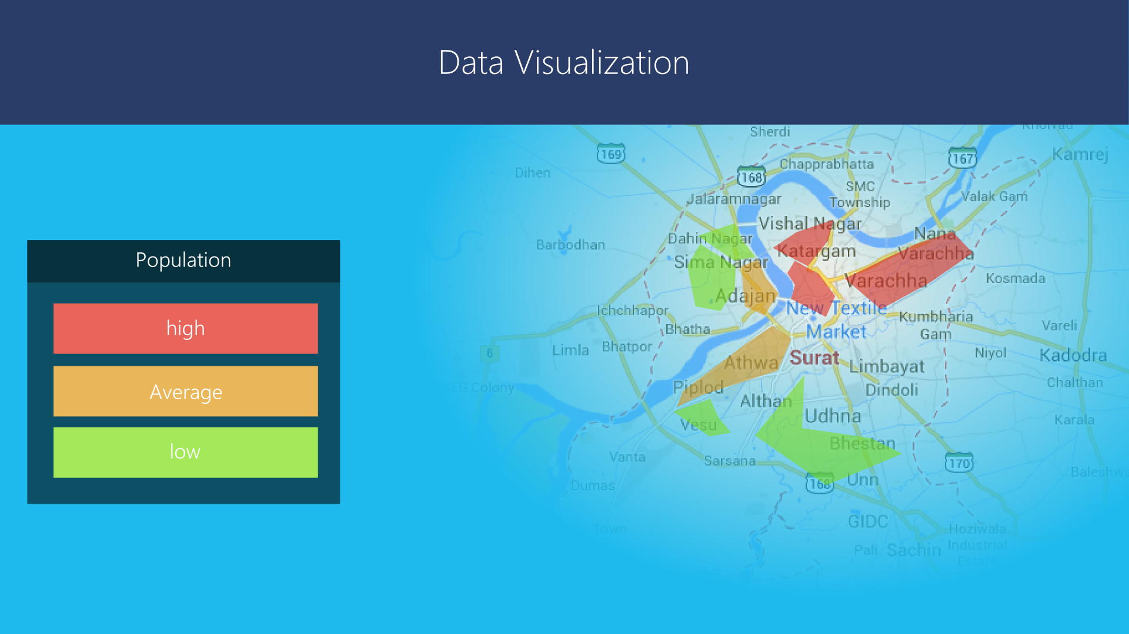
The data about population in different areas will be entered and will be used to visualize the area-wise population.

Slide 18
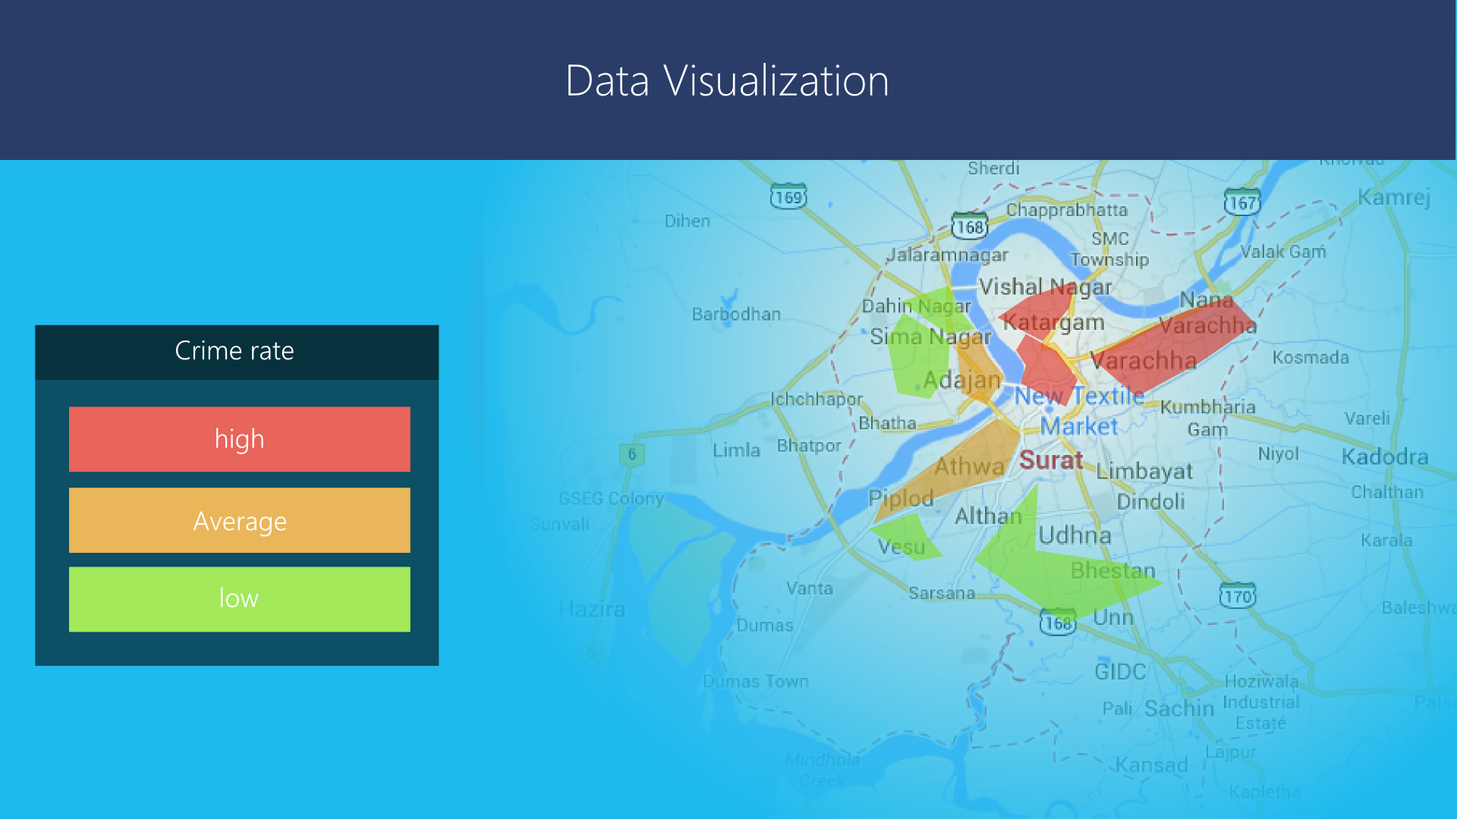
The data about crime-rate in different areas will be entered and will be used to visualize the area-wise crime-rate

Slide 19
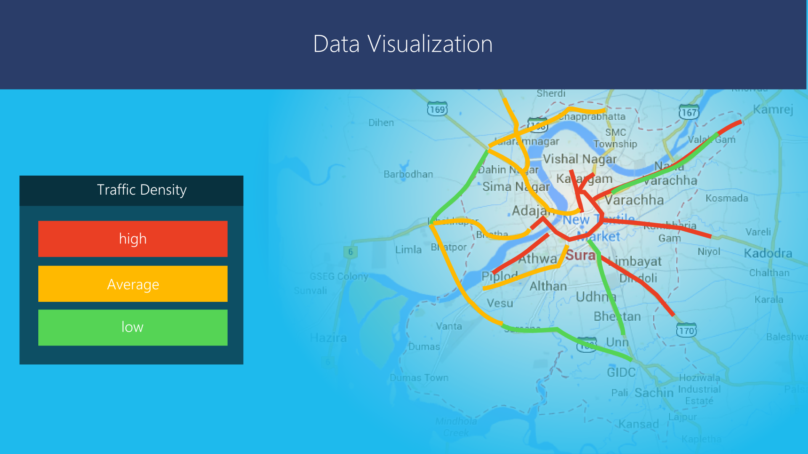

Slide 20
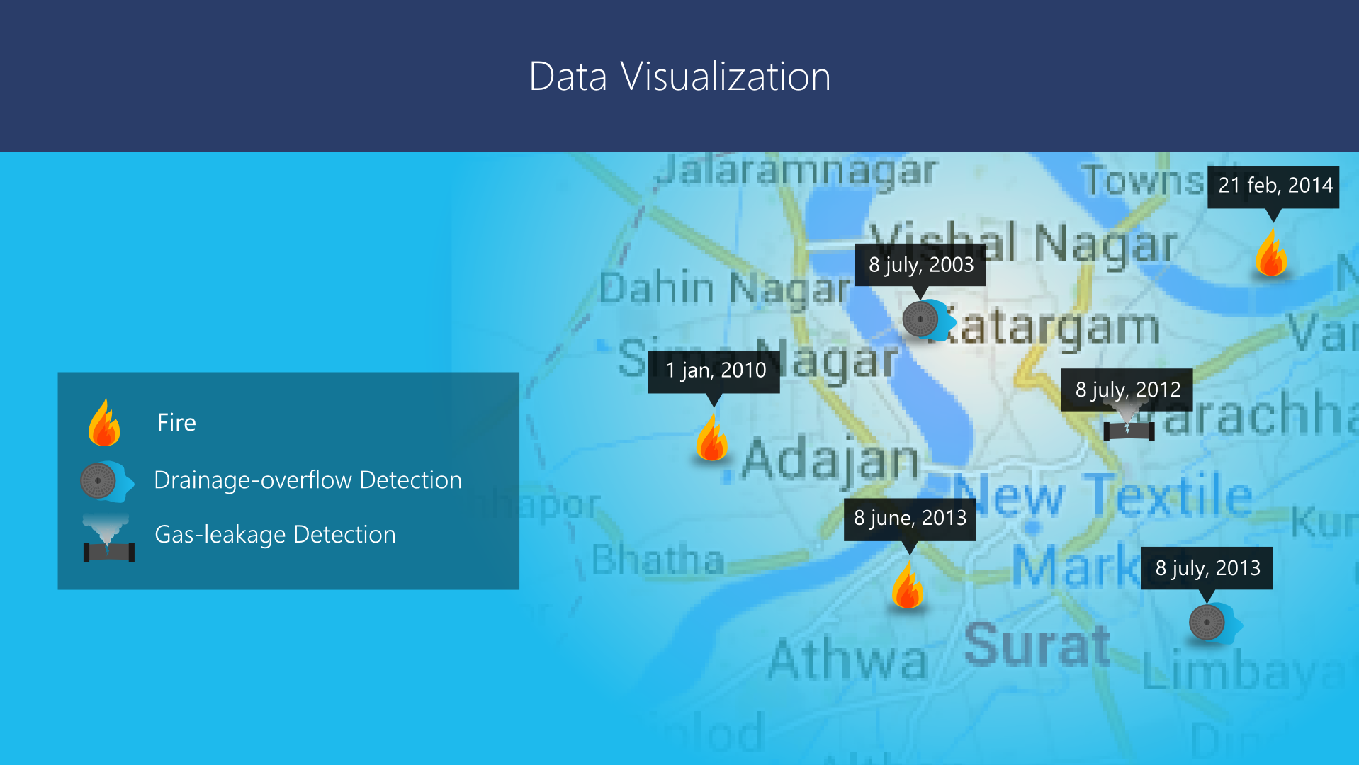

Slide 21

Components to be used in project
Hardware
Microcontroller (ATMEL® MEGA® 8-bit Series)
lectronic Components
Prototype Scaled Model
Software
Firmware (at hardware side)
Communication Firmware
Sensor Reader Firmware
Secondary Computer Firmware
Windows based software to control, monitor and as a primary processing system with AI
Communication – Module
GUI – Module
Map - Module

Slide 22
Proposed Project by Government of Gujarat GIFT city
GIFT(Gujarat International Financial Tec) city is planned as a globally benchmarked financial center between Ahmedabad and Gandhinagar as a Greenfield Development.
A smart city’s core infrastructure is information technology, where a network sensors, cameras, wireless devices, data centers form the key infrastructure providing essential services.
Construction of the Smart City in Gujarat called ‘GIFT city’, armored with all next generation amenities and technologies with uninterrupted power and water supply.
The highlight of the city will be an all-purpose 12 km long utilities tunnel, through which sewer lines, telephone lines, water pipes, power cables and other pipe lines preventing the need for underground and outdoor cables for the same

Slide 23


